Slide 1


Basic Electrical Technology [ELE 1051]
L27 – Electrical Machines (DC Motors & AC Motors)

Slide 2

Introduction to Electric machines
Electric motors may be broadly classified as
D.C motors
Induction motors
Synchronous motors
The last two categories of motors operate on alternating current.
Both ac and dc motors work with the Law of electro magnetic induction and Law of electromagnetic interaction such as Faraday’s law, Lenz’s law, Ampere's law, Biot-Savart’s law etc…
Dept. of Electrical & Electronics Engg., MIT - Manipal

Slide 3
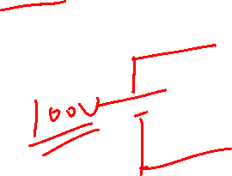
DC Motors
Dept. of Electrical & Electronics Engg., MIT - Manipal

Slide 5
Construction
Major parts are the stator and the rotor with an air gap in between.
Stator : houses the field winding
Rotor : carries the armature winding
Stator consists of
Yoke(or frame)
Poles
Brushes, brush holders and end covers
Rotor consists of
Armature
Commutator
Dept. of Electrical & Electronics Engg., MIT - Manipal

Slide 6
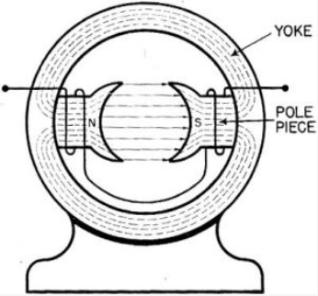
Construction
Yoke
Outer shell housing all the parts
Two end covers supporting the bearings
Cast steel is used as a material
Main Poles
The field coils are wound
When excited with dc , produce alternate North and South poles
Dept. of Electrical & Electronics Engg., MIT - Manipal

Slide 7
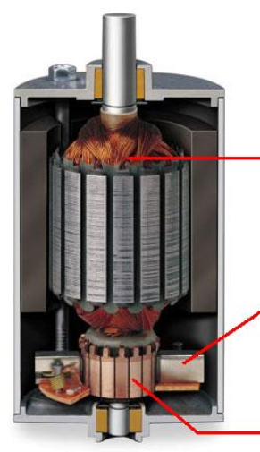

Construction
Armature
Rotating part of the DC machine.
Core is slotted to receive the armature winding.
Commutator
Mechanical Rectifier which rectifies AC to DC
Carbon Brushes rest on the surface of the commutator.
The brush holders provide slots for the brushes to be placed
Armature
coils
Brush
Commutator
Dept. of Electrical & Electronics Engg., MIT - Manipal

Slide 8
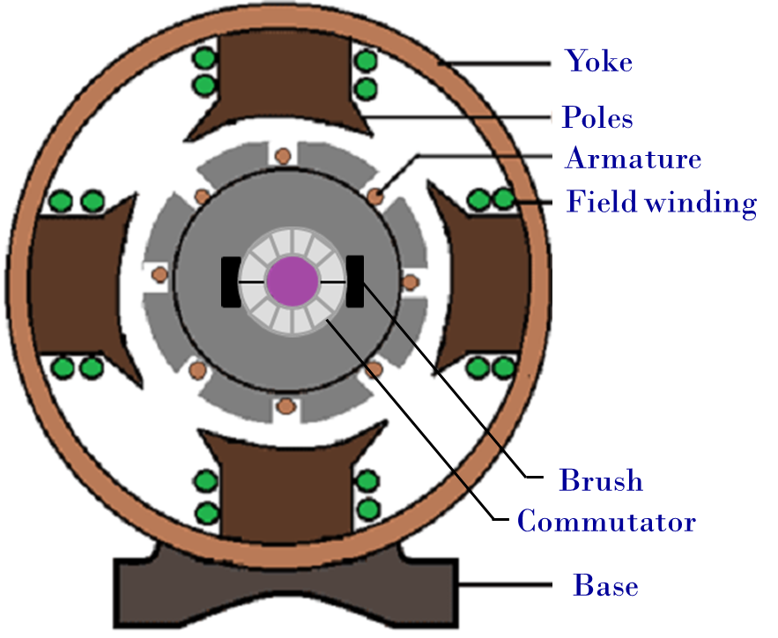
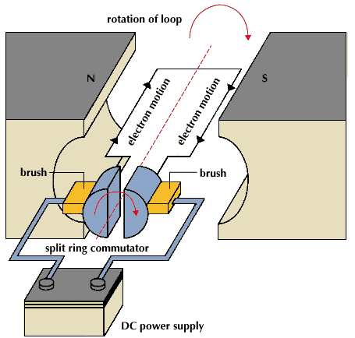

Working Principle
Dept. of Electrical & Electronics Engg., MIT - Manipal

Slide 9



Working Principle
Current carrying armature conductors placed in the magnetic field experience a force which rotates the armature.
Induced emf in armature conductor regulates the current drawn to match with the connected load.
The motor continues to operate in an equilibrium with motor torque balancing load torque and the tractive effort.
V = Voltage applied(Volts)
Eb = Induced Back e.m.f(Volts)
Ia = Armature current(Amperes)
Ra = Armature resistance(ohms)
N = Speed of the motor(r.p.m)
T = Torque developed(Nm)
Ø = Flux (Webers)
Dept. of Electrical & Electronics Engg., MIT - Manipal

Slide 12
Types of DC Motors
Shunt-Wound.
Series-Wound.
Compound-Wound.
Separately excited DC motor.
Dept. of Electrical & Electronics Engg., MIT - Manipal

Slide 13
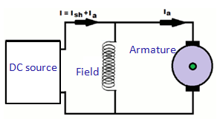
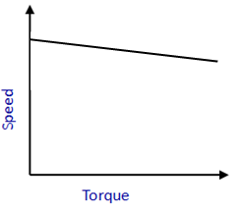
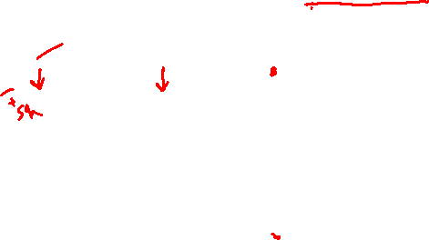
Types of DC Motors
DC Shunt Motor
Torque proportional to armature current.
Currents in the field and armature are independent of one another.
As a result, these motors have excellent speed control.
Speed Torque characteristics
Dept. of Electrical & Electronics Engg., MIT - Manipal

Slide 14
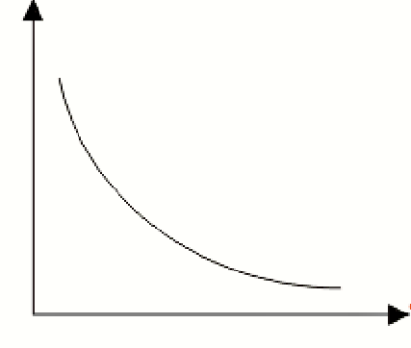
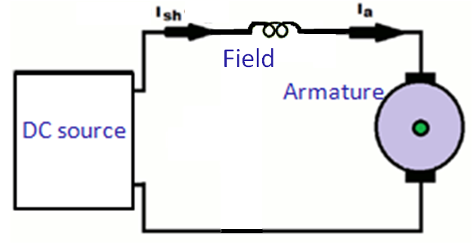

Types of DC Motors
DC Series Motor
Field and armature currents are equal
Torque is proportional to the square of the armature current
Starting torque quite high and its gets regulated automatically as speed increases.
Most preferred for Traction.
Speed
Speed Torque characteristics
Torque
Dept. of Electrical & Electronics Engg., MIT - Manipal

Slide 15
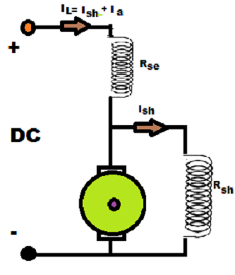
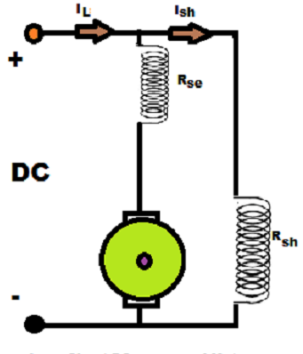
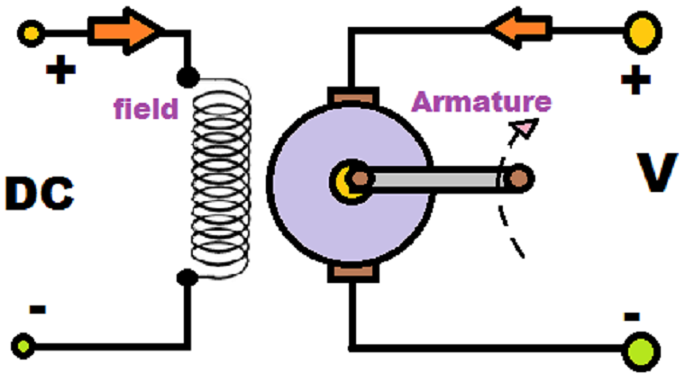

Types of DC Motors
DC compound motor Seperately excited DC motor
Dept. of Electrical & Electronics Engg., MIT - Manipal

Slide 16

Applications
D.C. shunt motor is used for drive requiring moderate torques.
D.C. series motor: Electric traction, high speed tools
D.C. compound motor :Rolling mills and other loads requiring large momentary torques
Dept. of Electrical & Electronics Engg., MIT - Manipal

Slide 17

Summary
D.C Motors can be shunt wound , series wound , compound wound or separately excited .
For a d.c motor

Slide 18
Basic Electrical Technology [ELE 1051]
L27- AC motors

Slide 19
Induction Motors
Dept. of Electrical & Electronics Engg., MIT - Manipal

Slide 20

Introduction
Nearly 80% of the world’s ac motors are poly-phase induction motors.
It has simple and rugged construction.
It is available from fractional horsepower ratings to megawatt levels.
There are machines available to operate from 3 phase or single phase electrical input
Single phase induction motors are restricted to small power levels (say less than 2 hp)
3 phase induction motors are widely used as pump & fan drives
For all practical purpose, it may be considered as a constant speed drive with full load slip around 3 %.
Dept. of Electrical & Electronics Engg., MIT - Manipal

Slide 21
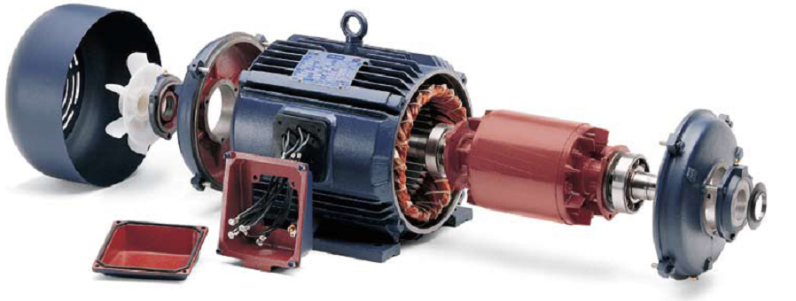
Construction
Stator
Rotor
Dept. of Electrical & Electronics Engg., MIT - Manipal

Slide 22
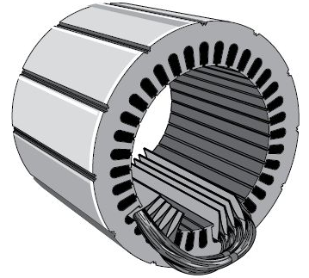
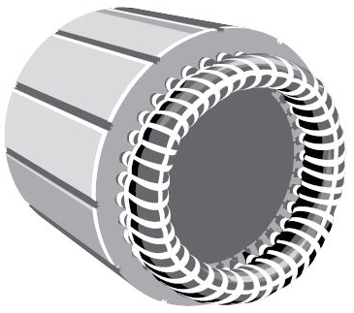
Construction
Stator
Stator frame (cast iron) provides mechanical support to the stator core
Stator core laminated and slotted to carry the 3 phase windings
The balanced windings are displaced in space by 120 degrees electrical
Stator core
Stator windings
Dept. of Electrical & Electronics Engg., MIT - Manipal

Slide 23
Construction
Types on the basis of rotor construction
Squirrel Cage Rotor
Slip Ring Rotor
Cylindrical Laminated core
Slots cutout on outer periphery
Conductors placed in slots
Dept. of Electrical & Electronics Engg., MIT - Manipal

Slide 24
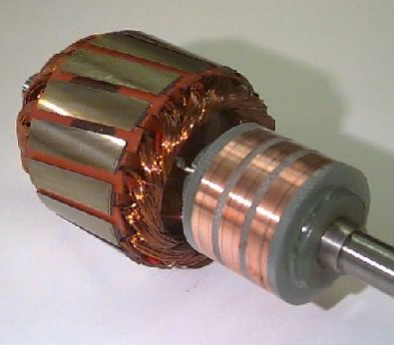
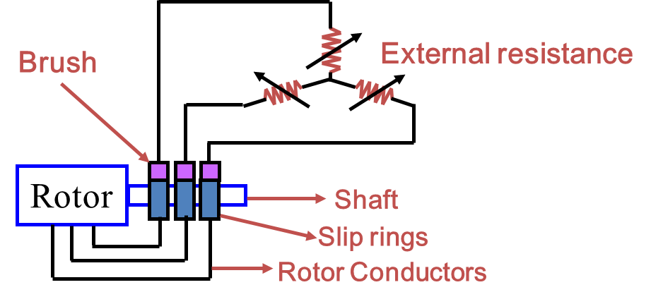

Construction
Wound Rotor
rotor winding is uniformly distributed and is usually connected in star.
The terminals of the winding are brought out to three slip rings
Slip rings in contact with brushes
Brushes connected to external resistance for higher starting torque
Dept. of Electrical & Electronics Engg., MIT - Manipal

Slide 25

Working Principle
3-phase currents flowing in the stator winding produce a rotating
magnetic field rotating at synchronous speed.

Slide 26
Working Principle
Direction of rotation of magnetic field
Stator
Rotating magnetic field is cut by the rotor conductor
EMF is induced in rotor conductor
Current in the rotor conductor sets up a magnetic field which opposes the rotation of main field
Main field is independent and hence rotor field tries to catch up the speed of main field to reduce the relative speed
Rotor rotates in the same direction as that of rotating magnetic field
Rotor
Rotating magnetic field
Rotor
Dept. of Electrical & Electronics Engg., MIT - Manipal

Slide 27
Working Principle
The axis of the magnetic field rotates at a synchronous speed
N_{S} = Speed of RMF, rpm
f = Frequency of ac supply, Hz
P = No. of poles
N_{S} = Synchronous Speed,rpm
N = rotor speed, rpm
If N = N_{S},
No flux cut by rotor conductors
No emf induced across rotor conductors
No current flow, no torque
Hence N < Ns must for rotor rotation
Dept. of Electrical & Electronics Engg., MIT - Manipal

Slide 28

Working Principle
Slip speed = (N_{S} – N), rpm
For rotor speed N, relative speed = N_{S} - N
Note
At instant of starting, N = 0, s =1 , f_{r} = f
Dept. of Electrical & Electronics Engg., MIT - Manipal

Slide 29
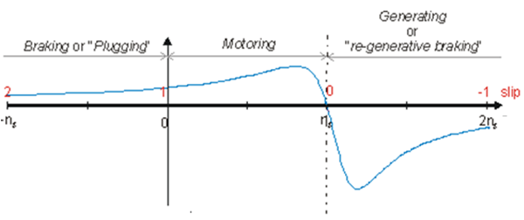
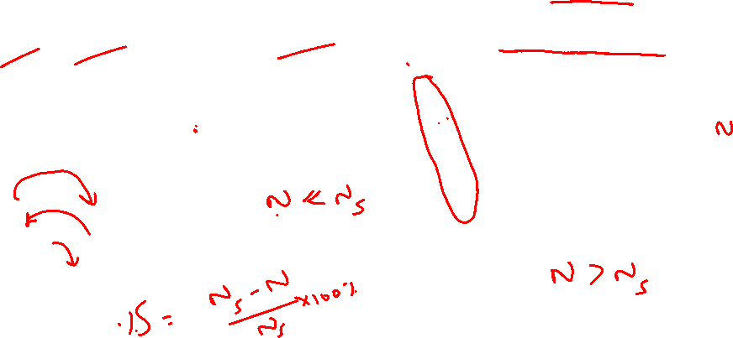
Speed-Torque Characteristics
Torque(Nm)`
Generating
or
re-generative braking
Braking or Plugging
Motoring
Slip
Speed(rpm)
Dept. of Electrical & Electronics Engg., MIT - Manipal

Slide 30
Applications
Industrial & Commercial Applications
Pumping Systems
Refrigeration Systems
Compressors
Fans & Blowers
Industrial Drives
Dept. of Electrical & Electronics Engg., MIT - Manipal

Slide 31
Single Phase Induction Motor
Dept. of Electrical & Electronics Engg., MIT - Manipal

Slide 32
Introduction
Construction is similar to 3 phase induction motor except the stator has TWO winding - starting & running.
The rotor is of squirrel cage type
A capacitor is connected in series with the starting winding to achieve phase split.
The motor is started as two phase machine.
Dept. of Electrical & Electronics Engg., MIT - Manipal

Slide 33
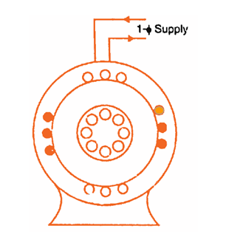
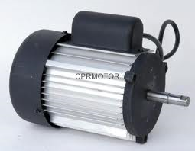
Construction
Stator
Rotor
Dept. of Electrical & Electronics Engg., MIT - Manipal

Slide 34
Working Principle –Double field revolving theory
Resultant field is alternating. Hence,
Single Phase induction motors are Not Self Starting in nature
Torque, Nm
Torque due to forward field T_{F}
Resultant Torque
Slip, %
2
1.5
1
0.5
0
Torque due to reverse field T_{B}
Dept. of Electrical & Electronics Engg., MIT - Manipal

Slide 35
Starting
The motor is started as two phase induction motor
Phase split is achieved by connecting a series capacitor with starting winding
Types
Capacitor Start Motor – pump / compressor motors
Capacitor Run Motor – ceiling fan motor
Dept. of Electrical & Electronics Engg., MIT - Manipal

Slide 36
Capacitor Start Motor
Starting Winding
Centrifugal Switch opens the circuit when speed is near about rated speed
Capacitor present in circuit only at starting
I_{st}
I₁
I_{st}
Capacitor
φ_{st}
Centrifugal
Switch
V
V
I_{m}
φ_{m}
I₁
I_{m}
Rotor
Main Winding
Dept. of Electrical & Electronics Engg., MIT - Manipal

Slide 37
Applications
Low power applications such as Air conditioners, Pumps, Fans.
Refrigerators, Washing Machines etc…
Dept. of Electrical & Electronics Engg., MIT - Manipal

Slide 38


Summary
Three phase Induction motors have inherent self- starting torque . It can never run at synchronous speed.
Single phase Induction motors are used for small power applications The common forms are capacitor start and capacitor run motor.
Dept. of Electrical & Electronics Engg., MIT - Manipal

